Slide 1



REVOLUTIONIZING VOTING WITH BLOCKCHAIN TECHNOLOGY
Explore the potential of blockchain technology in revolutionizing the voting system and ensuring secure and transparent elections.
Presented by:
PRANEET
(2302570049)

Slide 2

CURRENT STATE
OF
VOTING SYSTEMS
CONTENTS
INTRODUCTION
SECURITY OF
BLOCKCHAIN VOTING
& FUTURE
HOW BLOCKCHAIN
CAN
IMPROVE VOTING
IMPLEMENTING
BLOCKCHAIN
IN VOTING

Slide 3
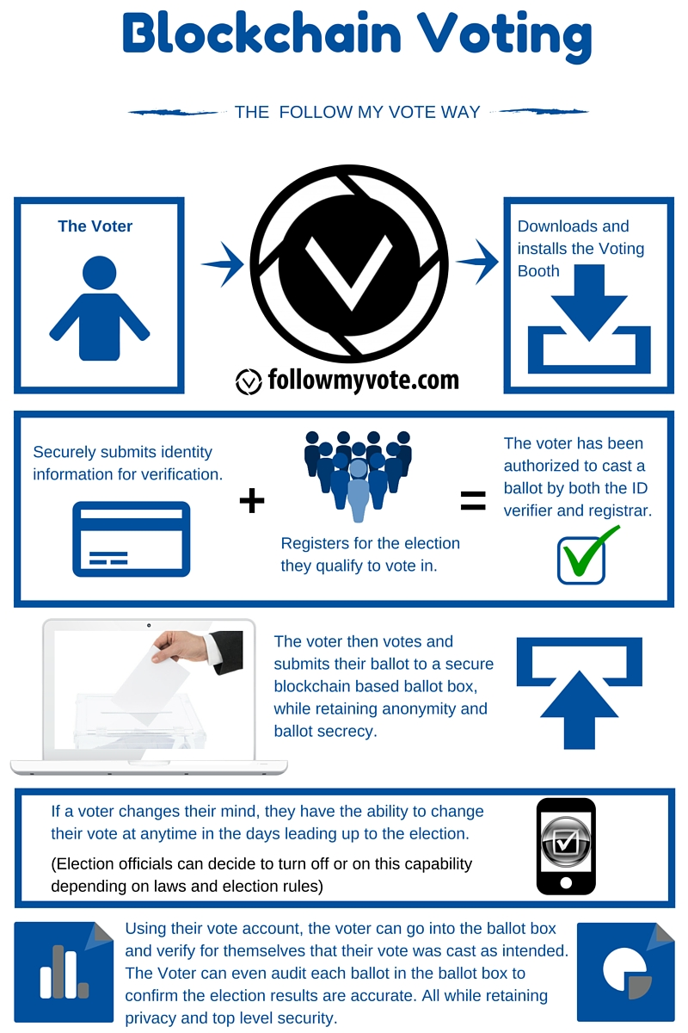

INTRODUCTION TO BLOCKCHAIN TECHNOLOGY
Blockchain is a decentralized, secure, and transparent method of storing and sharing data.
It can be used to create a more secure and trustworthy voting system that ensures the integrity of the democratic process.
Here are some of the benefits of using blockchain for voting:
Transparency: All votes are recorded on a public blockchain, which can be viewed by anyone. This makes it difficult to manipulate or tamper with votes.
Security: Blockchain is a very secure technology. It uses cryptography to protect data from unauthorized access.
Efficiency: Blockchain can help to streamline the voting process and make it more efficient. For example, it can be used to automatize tasks such as voter registration and vote counting.

Slide 4
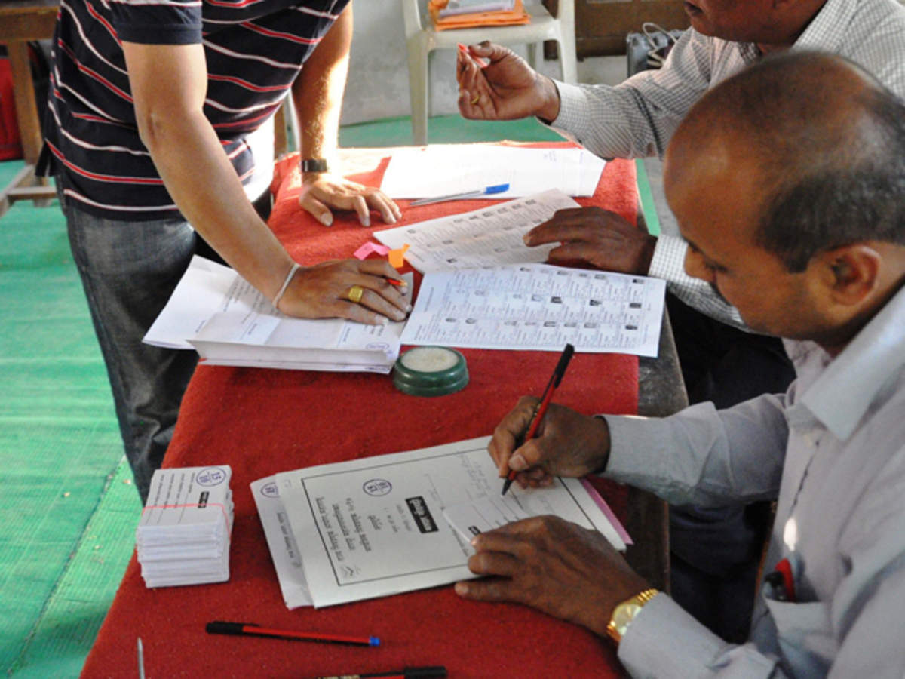

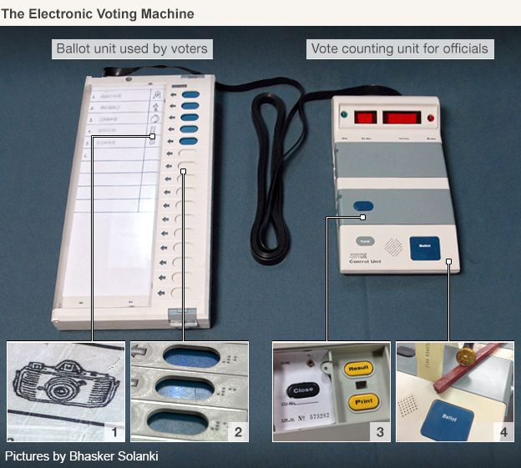
CURRENT STATE OF VOTING SYSTEMS
The current state of voting systems varies across different countries and regions. In some places, paper ballots are still used, while in others, electronic voting machines are more common. However, both types of systems have their own set of challenges and limitations.
Paper ballots:
Susceptible to errors and fraud
Difficult to count accurately and efficiently
Can lead to delays and disputes
Electronic voting machines:
Vulnerable to hacking and manipulation
Difficult to audit and verify
Can lead to voter distrust
Both types of systems can be expensive to maintain and upgrade.

Slide 5
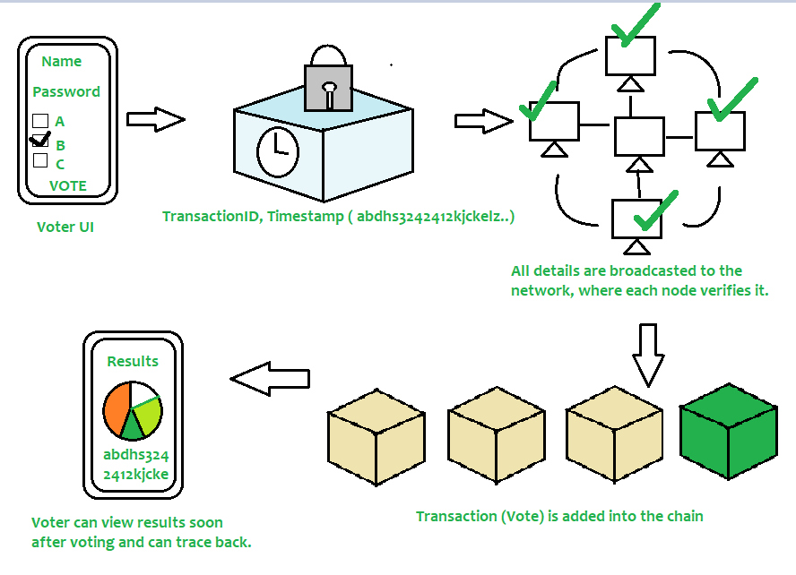
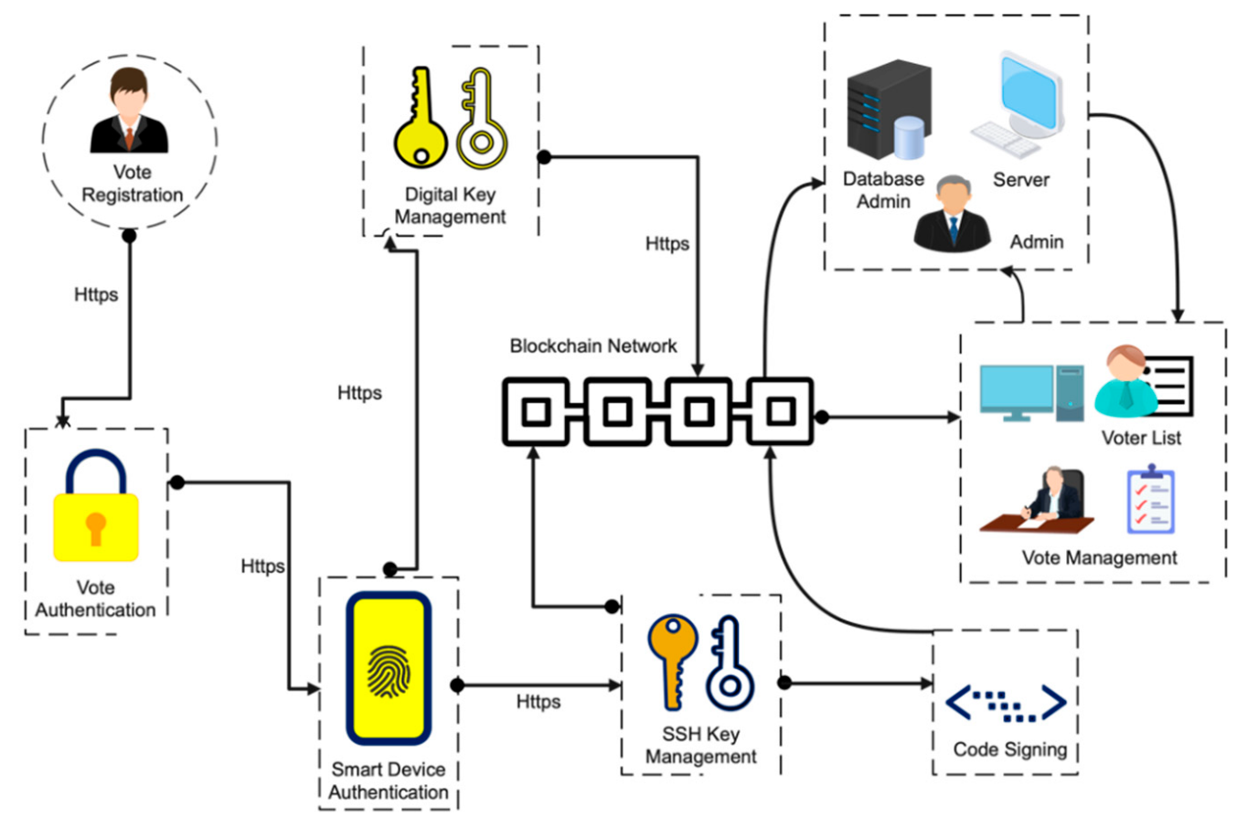
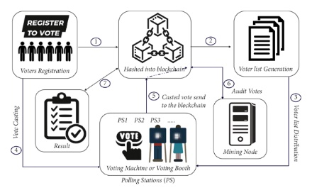
HOW BLOCKCHAIN CAN IMPROVE VOTING
Increased Transparency
Enhanced Security
Improved Accessibility
Blockchain technology can provide a transparent and tamper-proof record of each vote, ensuring that every vote is counted accurately and fairly.
Blockchain technology can help prevent fraud and hacking by creating a decentralized and secure system that is difficult to manipulate or corrupt.
Blockchain technology can make voting more accessible by allowing voters to cast their votes remotely and securely, reducing barriers to participation.

Slide 6
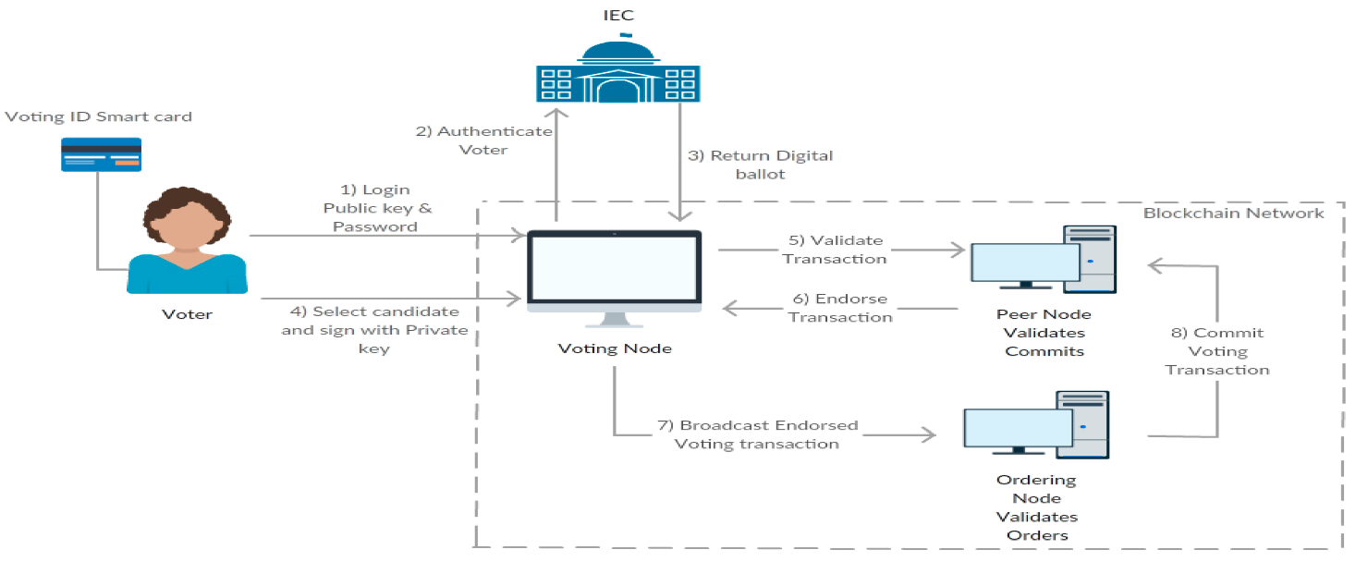

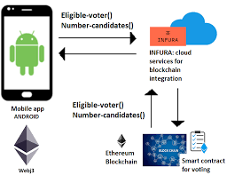
Part 04
IMPLEMENTING BLOCKCHAIN IN VOTING
Create a blockchain-based voting system that ensures transparency, security, and accuracy.
Develop a user-friendly interface that allows voters to easily cast their votes and verify their authenticity.
Establish a decentralized network of nodes that can validate and record votes in real-time.

Slide 7
Future of Voting with Blockchain
Increased Accessibility and Convenience
Increased Transparency and Security
Blockchain technology can improve the transparency and security of voting systems by providing an immutable record of all transactions. This ensures that votes cannot be altered or tampered with, and the results of the election can be trusted.
Blockchain voting can also increase accessibility and convenience for voters. With blockchain, voters can cast their ballots from anywhere in the world, without the need for physical polling stations. This can increase voter turnout and make the voting process more convenient for everyone.
Future Outlook
Challenges and Implementation
Blockchain voting is still new, but it has the potential to make voting better. More and more people are interested in using blockchain for voting, and with continued investment and innovation, blockchain voting could become the norm in the future.
Blockchain has the potential to make voting better, but we need to make sure that voters' privacy is protected, that no one can cheat, and that everyone can vote. This will require a lot of money and cooperation from different groups.

Slide 8


Thank You All
Presented by:
PRANEET
(2302570049)

